Slide 1
CONVOLUTIONAL NEURAL NETWORKS IN PRACTICE
Decoding Facial Expressions
Depressive vs. Neutral — A CNN Case Study
From convolutional neural networks in general, to the exact architecture trained on this dataset in PyTorch — with real results from a completed training run.
PRESENTED BY
PRESENTED TO
Muhammad Asad Riaz
Sir Kamran Younis
Dataset: gudiyasingh/emotion-dataset-for-mental-health (Kaggle) · Framework: PyTorch · Task: Binary image classification

Slide 2
FOUNDATIONS
What is a convolutional neural network?
A CNN learns to recognize visual patterns by passing an image through repeated layers that extract, compress, and finally classify features.
Input
Image
Convolution
Activation
(ReLU)
Pooling
(repeat)
Flatten
Fully
Connected
Output
Classes
Convolution
Activation (ReLU)
Pooling
Fully Connected
Slides small filters across the image, each learning to detect one visual pattern (an edge, a curve, a texture).
Introduces non-linearity — max(0, x) — so the network can approximate complex, non-linear decision boundaries.
Downsamples feature maps (e.g. take the max in each 2×2 window), keeping the strongest signal and reducing computation.
Flattens the final feature maps into a vector and combines them into class scores (logits).
Stacking these layers lets a CNN build up from simple edges (early layers) to complex, task-specific concepts (deeper layers) — the same idea every architecture on the next slide is built from.
Decoding Facial Expressions | CNN Case Study
2

Slide 3
CONTEXT
Other well-known CNN architectures
Before looking at the architecture used for this project, here's where it sits among widely-used CNN designs.
1998
2014
2015
2019
LeNet-5
VGG-16
ResNet-50
EfficientNet
First practical CNN — digit recognition
Deep stacks of small 3×3 convolutions
Residual/skip connections enable very deep nets
Compound scaling of depth/width/resolution
2012
2014
2017
AlexNet
GoogLeNet
MobileNet
ReLU + dropout + GPU training; ImageNet breakthrough
Inception modules; multi-scale filters per layer
Depthwise-separable convs for mobile efficiency
EmotionCNN (this project) is a small custom 3-block architecture — closest in spirit to the LeNet / early-VGG era of design.
Decoding Facial Expressions | CNN Case Study
3

Slide 4
THIS PROJECT'S MODEL
EmotionCNN — the architecture trained on this dataset
3 convolutional blocks (Conv → BatchNorm → ReLU → MaxPool) doubling channels while halving spatial size, then a dropout-regularized classifier head.
Input
Conv 3×3, 32
24×24×32
Conv 3×3, 64
12×12×64
Conv 3×3, 128
6×6×128
Flatten
Dropout .4
Dense 256, ReLU
Dropout .3
Dense → 2
1×48×48
BN → ReLU → Pool
BN → ReLU → Pool
BN → ReLU → Pool
4,608
logits
Conv block
Dense / dropout
Output
Feature-map size
1,273,538 trainable parameters
Decoding Facial Expressions | CNN Case Study
4

Slide 5
SCOPE & FRAMING
What this model is — and is not
This dataset is a relabeled facial-expression set (derived from the classic FER-style emotion images) — it is not clinically-diagnosed depression data.
A CNN trained on it learns to recognize an expression pattern the dataset creator labeled “depressive,” not to diagnose depression. Facial expression alone is not a validated clinical marker of depression.
1
2
3
Emotion-image classification demo
Not a diagnostic tool
Every result in this deck is real
Learns visual expression patterns from a labeled image set.
No clinical validation; outputs should never be read as a mental-health assessment.
Real training run, real numbers — reported with this caveat attached.
Decoding Facial Expressions | CNN Case Study
5

Slide 6
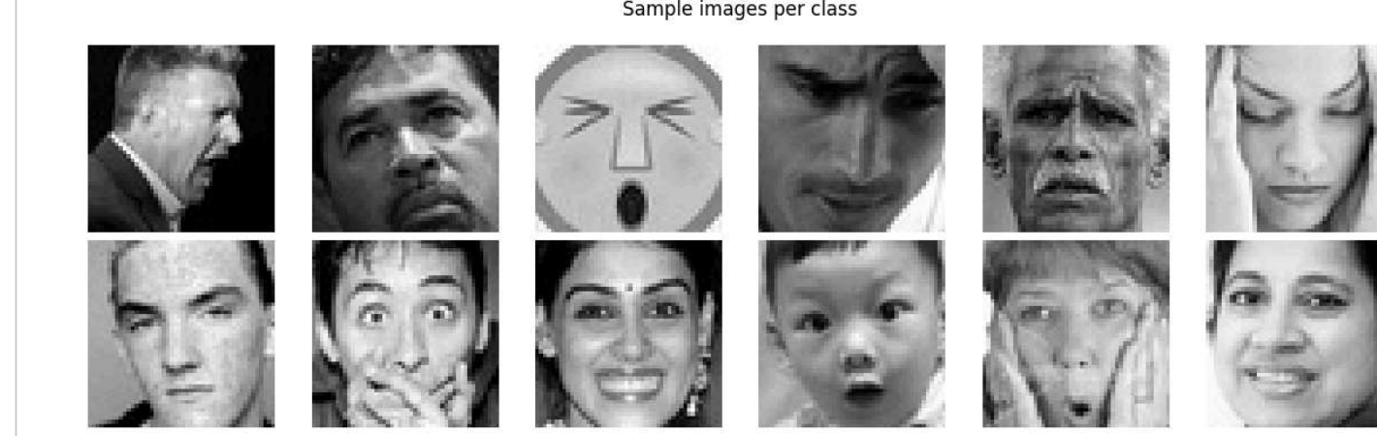
DATASET
Two-class facial-expression dataset
Dataset properties
Sample images per class
Source
Kaggle — gudiyasingh/emotion-dataset-for-mental-health
Classes
Depressive, Neutral
Image size
48 × 48
Color mode
Grayscale (1 channel)
Format
PNG / JPG
Split
Train / Validation / Test (author-provided)
Top row: depressive-labeled · Bottom row: neutral-labeled · raw dataset thumbnails, unaugmented
License
CC0: Public Domain
3,229 depressive • 3,838 neutral
Note: original FER-style emotion photos, relabeled by the dataset author — not clinically annotated.
images per split (train, validation, and test each carry this class distribution)
Decoding Facial Expressions | CNN Case Study
6

Slide 7
SAMPLE DATA PREPARATION
From raw image to model input
1
Grayscale
Force 1 channel for safety (images are already grayscale).
2
Resize
48 × 48 — native size, no upsampling needed.
3
Augment (train only)
Random horizontal flip (p=0.5) + random rotation (±10°) to curb overfitting.
4
ToTensor
Scales pixel values from [0, 255] to [0.0, 1.0].
5
Normalize
Zero-center with dataset mean=0.5057, std=0.2128 — stabilizes gradient-based training.
Decoding Facial Expressions | CNN Case Study
7

Slide 8
TRAINING PROCESS
Training configuration
OPTIMIZER
LR SCHEDULE
LOSS FUNCTION
Adam
ReduceLROnPlateau
CrossEntropyLoss
lr = 1e-3
factor 0.5, patience 3, on val loss
softmax applied internally
BATCH SIZE
EPOCHS
REGULARIZATION
64
30
BatchNorm + Dropout
early-stopped on best val loss
0.4 / 0.3 + light augmentation
One manual optimizer step, traced end to end: loss 0.7423 → backward() → gradients confirmed flowing from fc2 (norm 1.20) all the way back to block1 conv (norm 0.32) → optimizer.step() → loss 0.6395.
Decoding Facial Expressions | CNN Case Study
8

Slide 9
TRAINING PROCESS
Training run — loss & accuracy
Decoding Facial Expressions | CNN Case Study
9

Slide 10
RESULTS
Test-set performance
Confusion matrix — test set
TEST ACCURACY
Predicted
82.4%
Depressive
Neutral
Depressive
2579
650
7,067 held-out test images
Class Precision Recall F1
True
Depressive
0.81
0.80
0.81
Neutral
592
3246
Neutral
0.83
0.85
0.84
Macro avg
0.82
0.82
0.82
Best checkpoint: epoch 28 · val loss 0.3687 · val acc 82.4%
Decoding Facial Expressions | CNN Case Study
10

Slide 11
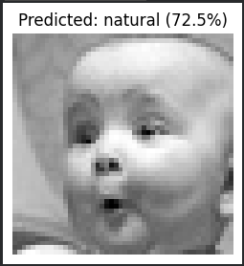
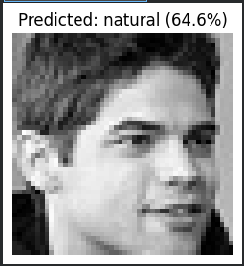
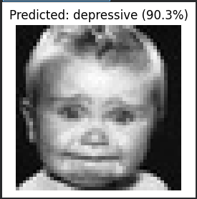
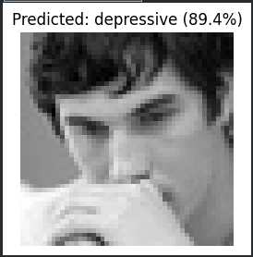
RESULTS
Live inference on new photos
The trained checkpoint's predict_image() pipeline run on four photos uploaded directly through the notebook's file-upload widget — not from the dataset.
Natural
Natural
Depressive
Depressive
(72.5% confidence)
(64.6% confidence)
(90.3% confidence)
(89.4% confidence)
dep.
27.5%
dep.
35.4%
dep.
90.3%
dep.
89.4%
nat.
72.5%
nat.
64.6%
nat.
9.7%
nat.
10.6%
Note: an emotion-image classification demo, not a clinical depression assessment — not for interpreting real people's mental health.
Decoding Facial Expressions | CNN Case Study
11

Slide 12
DISCUSSION
Observations & limitations
What worked
Where it would break down
BatchNorm + Dropout(0.4/0.3) kept the train/val gap small — val accuracy tracked above train accuracy for most of training.
82.4% accuracy leaves a meaningful error rate — 650 depressive images misclassified as neutral, 592 the other way.
ReduceLROnPlateau caught the point of diminishing returns; best checkpoint landed at epoch 28 of 30.
“Depressive” here means an expression pattern the dataset author labeled, not a diagnosis — the model has no access to clinical ground truth.
Light augmentation (flip + ±10° rotation) was enough regularization for a ~14k-image dataset — no signs of memorization.
Train/validation/test splits carry identical class counts (3,229 / 3,838 each) — worth double-checking the split wasn't inadvertently duplicated before trusting val/test as independent.
Decoding Facial Expressions | CNN Case Study
12

Slide 13
TAKEAWAYS
A real pipeline, honestly reported
Built up from CNN fundamentals, through well-known architectures, to a from-scratch PyTorch CNN (1.27M params) reaching 82.4% test accuracy on a genuinely held-out 7,067-image test set.
Every number in this deck — the curves, the confusion matrix, the metrics, all four live-inference examples — comes from real runs, not placeholders.
The task is expression-image classification, not clinical depression detection — that distinction is reported everywhere in this deck, not just once.
Next step: verify the train/val/test split independence, then evaluate on a second facial-expression dataset to check generalization.
Decoding Facial Expressions | CNN Case Study

